Slide 1
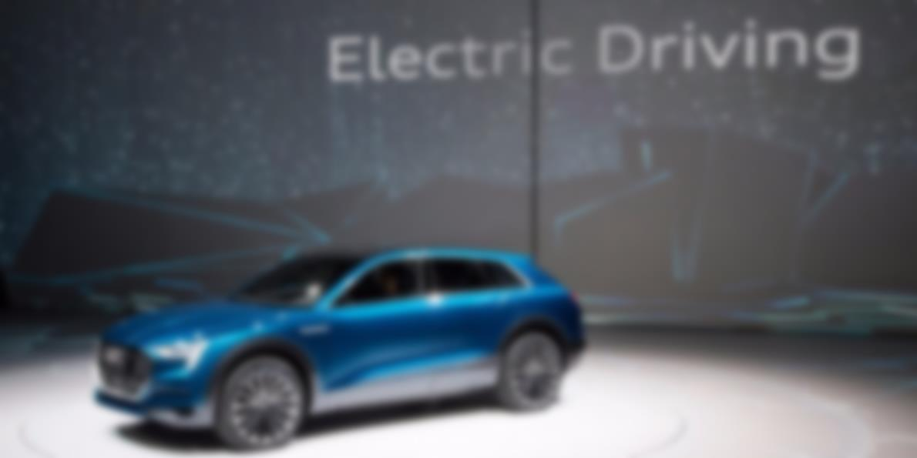
ONLINE ELECTRIC CAR PURCHASER SOFTWARE SYSTEM
Presented by:
Maryam Musaddiq 3183
Hina Babur 3157
Nimrah Yousuf 3178

Slide 2
CONTENTS
Introduction
Background
Purpose
Scope
Work Breakdown Structure
Activity Graph
Critical Path
Gantt Chart

Slide 3
Contents(..cont.)
Use Case Diagram
System Sequence Diagram
Sequence Diagram
Class Diagram
Test Cases

Slide 4
Introduction
The aim of this document is to gather, analyze and give an in-depth insight of the complete Software System
This proposed system can be used by any naive users and it does not require any educational level, experience or technical expertise in computer field but it will be of good use if user has the good knowledge of how to operate a computer

Slide 5
BACKGROUND
Online purchasing is a form of electronic commerce which allows consumers to directly buy over the Internet
Customer service representatives available 24 hours a day, 7 days a week to assist you with locating, purchasing and shipping your merchandise

Slide 6
Purpose
This document is meant to delineate the features of Online Electric Car Purchaser Software System
It will enable company to setup online shop and customer to browse through the shop and purchase them online without having to visit the shop physically

Slide 7
Main Objectives
To shop within the comfort of your own home, without having to step out of the door.
Design Studio
New inventory
Test drive

Slide 8
Scope
The scope pertains to the features for making Online Car Purchaser Software System. Following are the features:
This system is about converting the shopping system from manual to online.
Customer can buy products online after login to the site.
Customer can edit or remove product from cart.
After buying and making payment the products are send to customers address that he has given.
Administrator is adding the delivery report to the database.
Both admin and customer can see the delivery report.

Slide 9
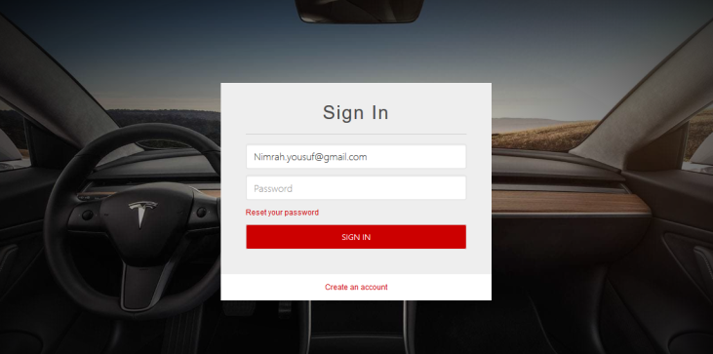
FUCTIONAL REQUIREMENTS
REGISTRATION
If customer wants to buy the product then he/she must be registered, unregistered user can’t go to the shopping cart. Registered customers can simply sign-in using email-id and password.

Slide 10
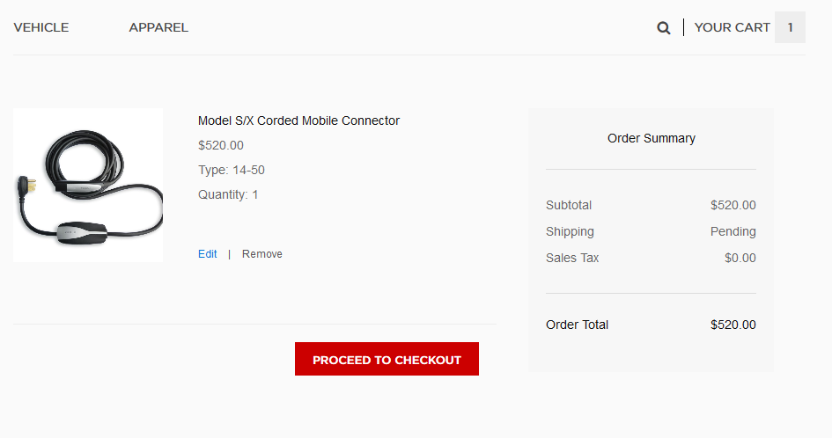
FUCTIONAL REQUIREMENTS
CART
Add to Cart is a way to create a temporary list of items by adding them to your cart, which will keep track of the items

Slide 11
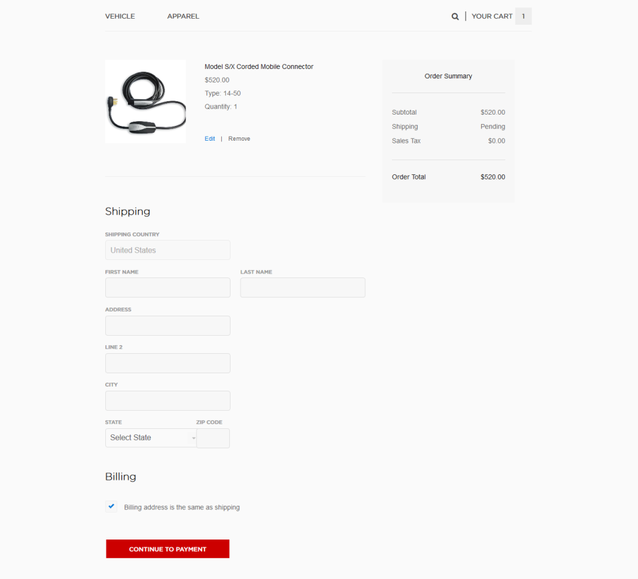
FUCTIONAL REQUIREMENTS
Payment
In this system we are dealing the mode of payment by Cash. You can pay online through PayPal, debit cards, credit cards or cash on delivery. You can lease or loan your car too.

Slide 12
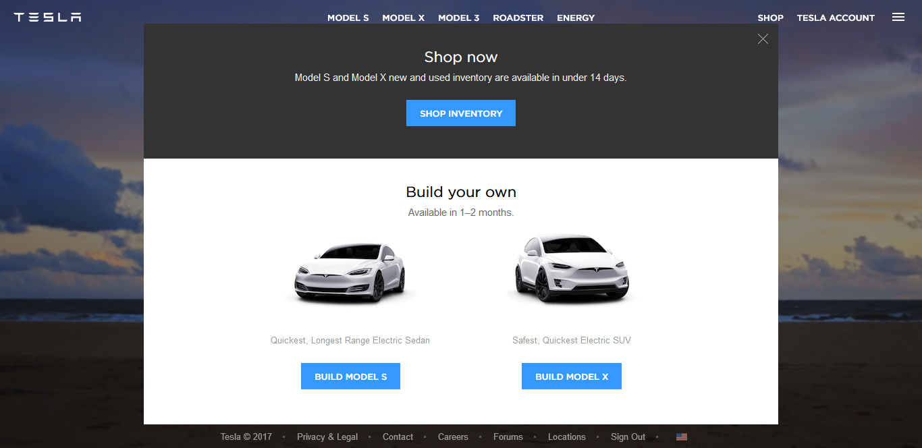
FUCTIONAL REQUIREMENTS
Design Studio
You can customize your car here with your desirable features and purchase it

Slide 13
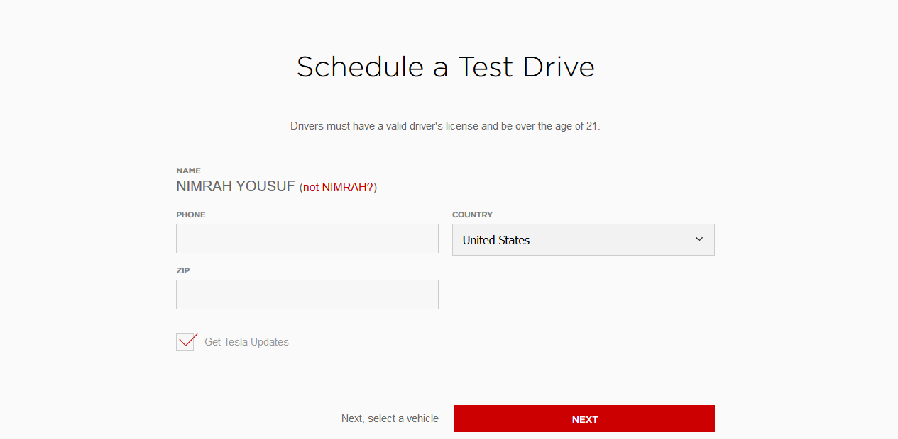
FUCTIONAL REQUIREMENTS
Test Drive
A test drive is the driving of an automobile to assess its drivability, or roadworthiness, and general operating state. You can request a test drive online for appointment

Slide 14
NON-FUNCTIONAL REQUIREMENTS
Following Non-functional requirements will be there in the Insurance on internet:
Security
Reliability
Maintainability
Portability
Reusability
Application Affinity/Compatibility

Slide 15
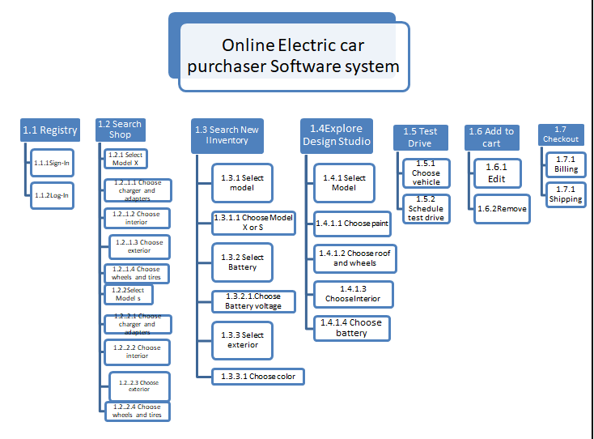
WBS

Slide 16
Activities | ID |  | Predecessor |  | Duration | Early Start | Early Finish
Search Shop |  | A |  | - | 2d | 0 | 1
Select Model |  | B |  | A | 1d | 1 | 3
Model X |  | C |  | B | 1d | 3 | 6
Model S |  | D |  | B | 1d | 3 | 4
Select Chargers and adapters |  | E |  | C,D | 2d | 6 | 10
Select Interior |  | F |  | C,D | 2d | 6 | 8
Select Exterior |  | G |  | C,D | 3d | 6 | 9
Select Wheels and tires |  | H |  | C,D | 1d | 6 | 10
Add to cart |  | I |  | E,F,G,H | 3d | 10 | 15
Checkout |  | J |  | Q,I | 1d | 20 | 26
Build your own |  | K |  | - | 7d | 0 | 5
Design Studio |  | L |  | K | 7d | 5 | 11
Choose Paint |  | M |  | L | 1d | 11 | 12
Choose Roof and wheels |  | N |  | L | 1d | 11 | 13
Choose Interior |  | O |  | L | 1d | 11 | 14
Choose Battery |  | P |  | L | 1d | 11 | 15
Save design |  | Q |  | M,N,O,P | 3d | 15 | 20
Test drive |  | R |  | - | 1d | 0 | 1
Schedule Test Drive |  | S |  | R | 2d | 1 | 3
Select Vehicle |  | T |  | R | 2d | 1 | 4

Slide 17
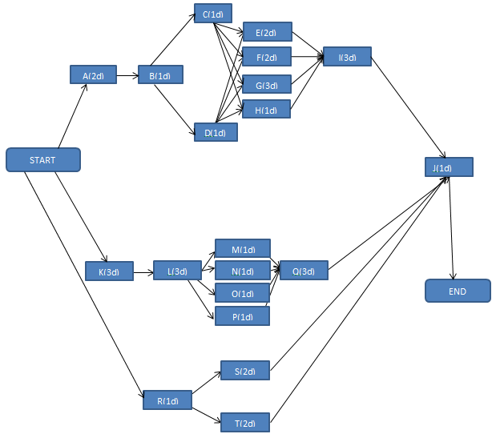
ACTIVITY GRAPH

Slide 18
CRITICAL PATH
A+B+C+E+I+J = 1+2+3+4+5+6 = 21
A+B+C+F+I+J=1+2+3+2+5+6 =19
A+B+C+G+I+J=1+2+3+3+5+6=20
A+B+C+H+I+J=1+2+3+4+5+6=21
A+B+D+E+I+J=1+2+1+4+5+6=19
A+B+D+F+I+J=1+2+1+2+5+6=17
A+B+D+G+I+J=1+2+1+3+5+6=18
A+B+D+H+I+J=1+2+1+4+5+6=19
K+L+M+Q+J=5+6+1+5+6=23
K+L+N+Q+J5+6+2+5+6=24
K+L+O+Q+J=5+6+3+5+6=25
K+L+P+Q+J=5+6+4+5+6=26 Critical Path
R+S+J=1+2+6=9
R+T+J=1+3+6=10

Slide 19
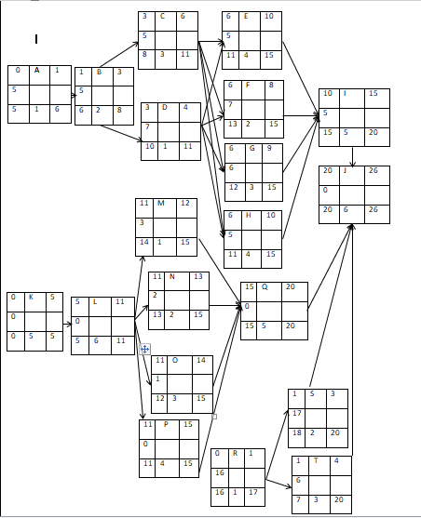

Slide 20
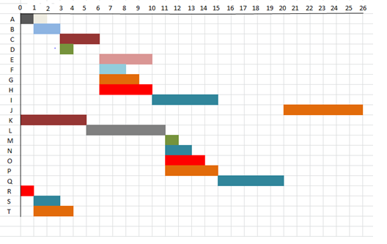
GANTT CHART

Slide 21
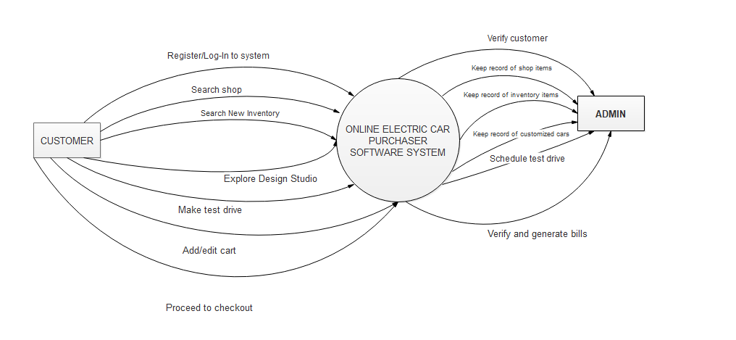
CONTEXT LEVEL DFD

Slide 22
LEVEL 1 DFD
C:\Users\hp\Documents\ELECTRIC CAR\DFD.docx

Slide 23
ERD
C:\Users\hp\Documents\ELECTRIC CAR\ERD.docx

Slide 24
USE CASE DIAGRAM
USE CASE.docx

Slide 25
SYSTEM SEQUENCE DIAGRAM
C:\Users\hp\Documents\ELECTRIC CAR\System sequence.docx

Slide 26
SEQUENCE DIAGRAM 1
C:\Users\hp\Documents\ELECTRIC CAR\SEQUENCE 1.docx

Slide 27
SEQUENCE DIAGRAM 2
C:\Users\hp\Documents\ELECTRIC CAR\SEQUENCE 2.docx

Slide 28
SEQUENCE DIAGRAM 3
C:\Users\hp\Documents\ELECTRIC CAR\SEQUENCE 3.docx

Slide 29
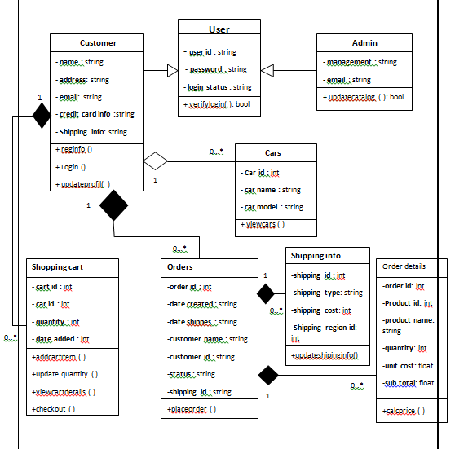
CLASS DIAGRAM

Slide 30
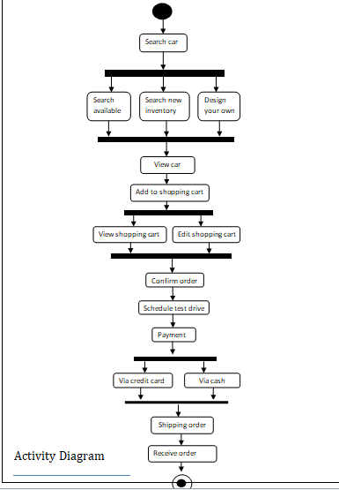
ACTIVITY DIAGRAM

Slide 31
TEST CASE
ELECTRIC CAR\test cases final.docx

